Slide 1

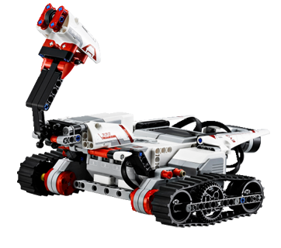
Lego Mindstorms

Slide 2
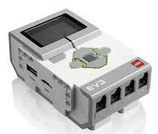
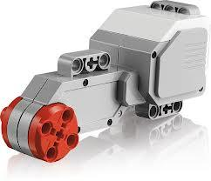
What is your robot made of ?
An EV3 brick on which sensors and motors are plugged. We will build our programs on the computer, and then upload them into this brick.
2 large motors to drive the robot.

Slide 3
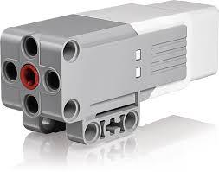
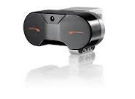
What is your robot made of ?
1 medium motor for other mechanisms.
1 infrared sensor to detect objects and measure the distance to them.

Slide 4
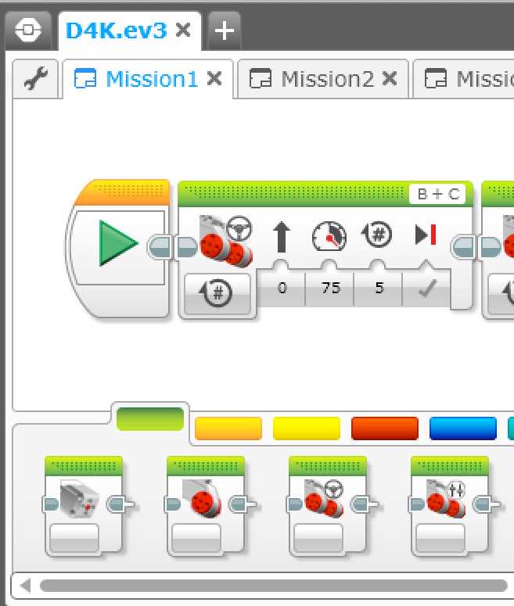
How to program it ?
We will give instructions to the robot by adding graphical blocks one to each other. We could make the robot :
move around,
wait,
play a sound,
display pictures, ...

Slide 5

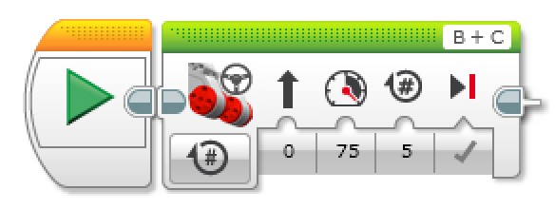
Mission #1 : Make an half turn
Goal : The robot moves forwards, makes a 180-degree turn and moves forwards again to came back at the same position as the beginning.
1. Add a new program
1
2. Place a Move Steering block after the start block
3. Change the mode to On for Rotations
4. Change the rotation number by 5
3
4

Slide 6
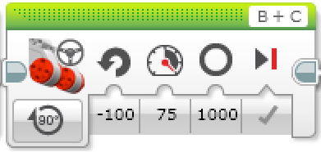
Mission #1 : Make an half turn
5. Place a Move Steering block after the previous one
6. Change the mode to On for degrees
7. Change the steering value by -100
8. Change the degrees value by 1000
6
7
8

Slide 7

Mission #1 : Make an half turn
9. Place a Move Steering block after the previous one
10. Change the mode to On for Rotations
11. Change the rotation number by 5
10
11

Slide 8
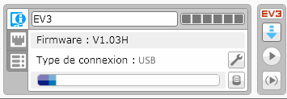
Mission #1 : Make an half turn
12. Connect your EV3 Brick.
13. Download the program
13
14. Run the program (Folder icon > TRACK3R > Program2)

Slide 9
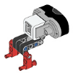
Mission #2 : Detect an obstacle
Goal : The robot moves around continuously. If it detects something at a certain distance, it stops and plays a sound. If not, it continues to move around.
1. Add the infrared sensor in front of the EV3 Brick and plug it to the port 4
2. Add a new program
2

Slide 10
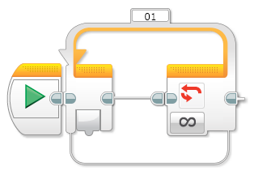
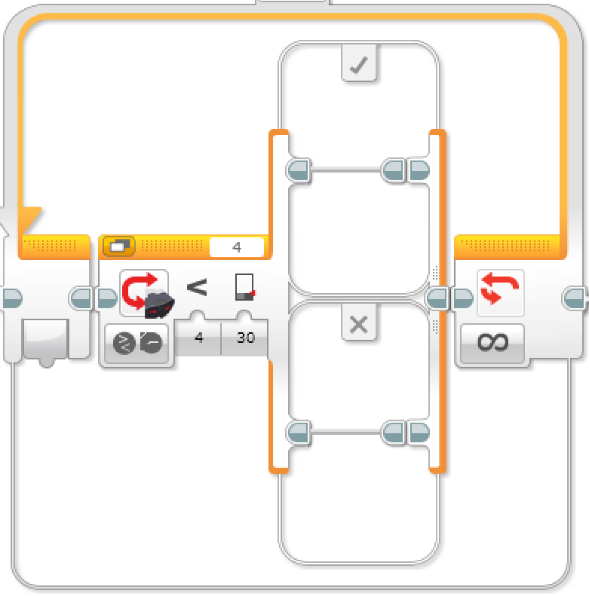
Mission #2 : Detect an obstacle
3. Place a Loop block after the start block
4. Place a Switch block inside the loop block.
5. Change the mode to Infrared sensor > Compare > Proximity
6. Change the threshold value by 30
5
6

Slide 11
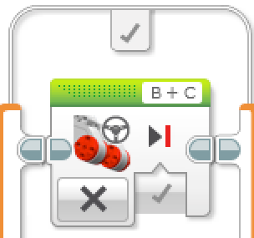
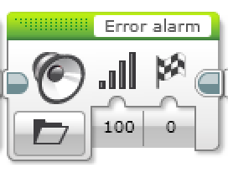
Mission #2 : Detect an obstacle
7. Place a Move Steering block inside the True case of the switch block.
8. Change the mode to Off
8
9. Place a Sound block after the move steering block
10. Select the Error alarm sound (menu LEGO sound files > Informations )
10

Slide 12
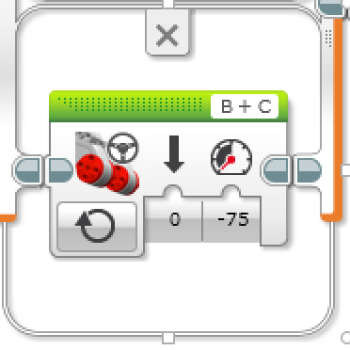
Mission #2 : Detect an obstacle
11. Place a Move Steering block inside the False case of the switch block.
12. Change the mode to On
13. Change the power value by -75
12
13

Slide 13
Mission #2 : Detect an obstacle
14. Connect your EV3 Brick.
15. Download the program
15
16. Run the program (Folder icon > TRACK3R > Program2)

Slide 14
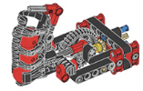
Mission #3 : Hunt the intruders !
Goal : The robot moves around continuously. If it detects something at a certain distance, it stops, plays a sound alert and waits for 3 seconds. If the obstacle has not move after 3 seconds, the robot shoots a ball.
1. Add the shoot mechanism on the medium motor
2. Pick up the previous program

Slide 15
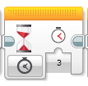
Mission #3 : Hunt the intruders !
3. Place a Wait block inside the True case of the switch block
4. Change the seconds value by 3
4

Slide 16
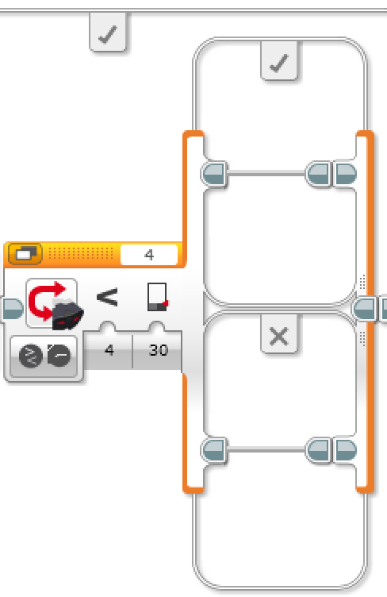
Mission #3 : Hunt the intruders !
5. Place a Switch block inside the True case of the switch block
6. Change the mode to Infrared sensor > Compare > Proximity
7. Change the threshold value by 30
6
7

Slide 17
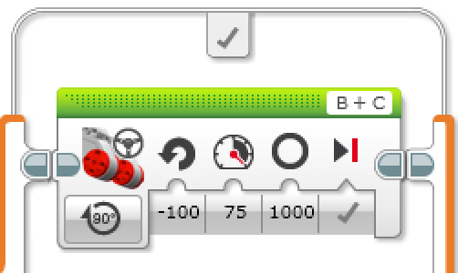
Mission #3 : Hunt the intruders !
8. Place a Move Steering block inside the True case of the switch block.
9. Change the mode to On for Degrees
10. Change the direction by -100
11. Change the degrees by 1000
9
10
11

Slide 18
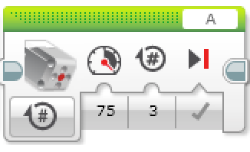
Mission #3 : Hunt the intruders !
12. Place a Medium Motor block inside the True case of the switch block.
13. Change the mode to On for Rotations
14. Change the rotations number by 3
13
14

Slide 19
Mission #3 : Hunt the intruders !
15. Connect your EV3 Brick.
16. Download the program
16
17. Run the program (Folder icon > TRACK3R > Program2)

Slide 20
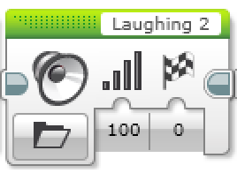
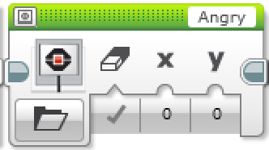
Up to you !
Add sounds and pictures to make your robot alive :
to make the robot play a sound, add a Sound block and select the sound
to display pictures on the EV3 brick, place a Display block and select the picture

